Slide 1
Rotary Club of Space Center August 6, 1964 – August 6, 2014 50 Years in Photos

Slide 2
“Service Above Self”

Slide 3
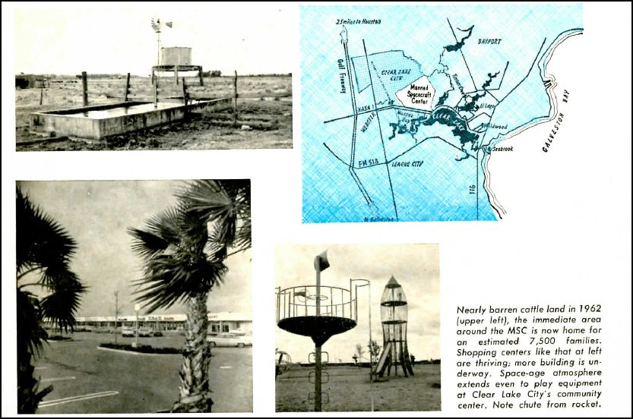
Johnson Space Center and Clear Lake 1960’s

Slide 4
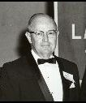
Ivan. E. Brown President 1964-65

Slide 5
Ivan. E. Brown President 1965-66

Slide 6
Notice of Admission to Membership in Rotary International

Slide 7
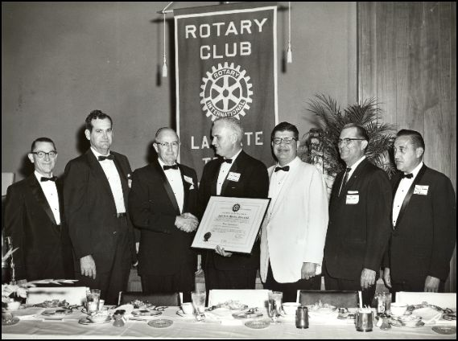
Charter Presentation September 28, 1964

Slide 8
New Club Banner 1965

Slide 9
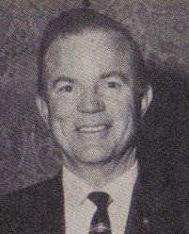
Martin Gracey President 1966-67

Slide 10
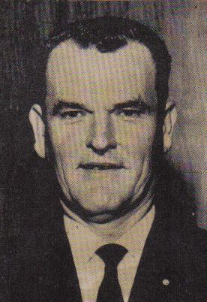
Richard Allen President 1967-68

Slide 11
First Available Blastoff March 2, 1967

Slide 12
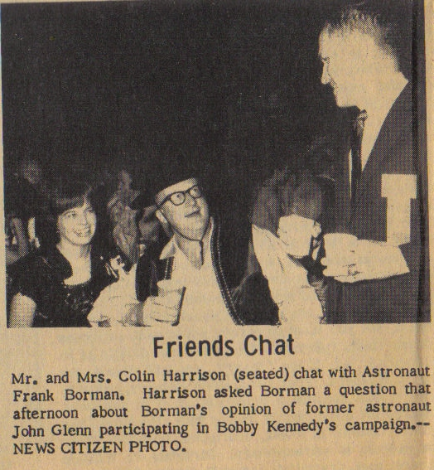
Astronaut Frank Borman Chats with Club Members - 1967

Slide 13
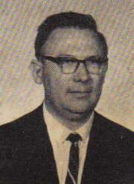
Jerome "Jerry" B. Hammack President 1968-69

Slide 14
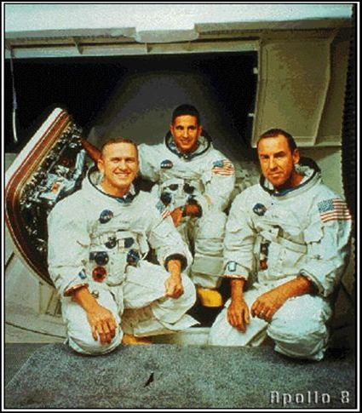
Club Banner Circumnavigates the Moon in Apollo 8 December 1968

Slide 15
President of Rotary International (center) visited Johnson Space Center September 13, 1968

Slide 16
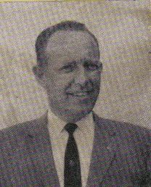
Roger F. Hobart President 1969-70

Slide 17
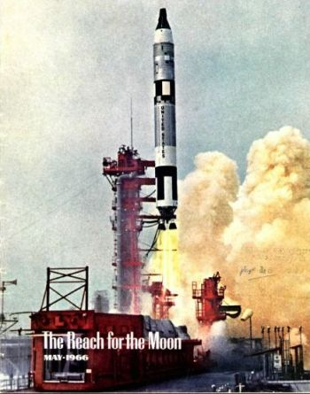
May 1969 Rotarian had article on Rotary Club of Space Center

Slide 18
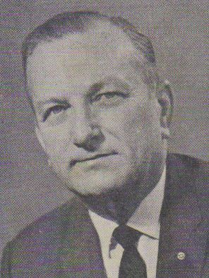
Orville G. "Gene" Lindquist President 1970-71

Slide 19
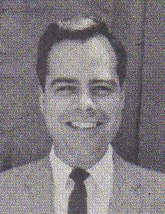
Robert "Bob" K. Scott President 1971-72

Slide 20
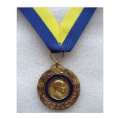
The Club awarded posthumously its first Paul Harris Fellow to Harry Smith following his death on August 1972 to his wife, Pat, at the July 30, 1973 Club meeting

Slide 21
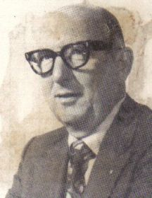
Frank Morgan President 1972-73

Slide 22
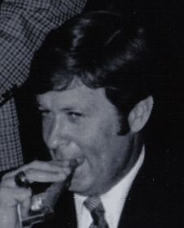
Rex Bailey President 1973-74

Slide 23
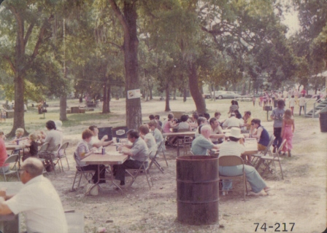
First Shrimporee July 20, 1974 Galveston Park League City, Texas

Slide 24
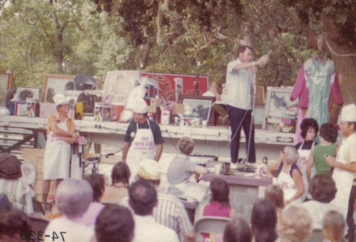
First Shrimporee July 20, 1974 Live Auction from Truck Trailer

Slide 25
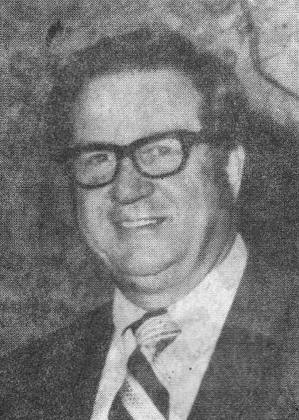
Richard Chandler President 1974-75

Slide 26
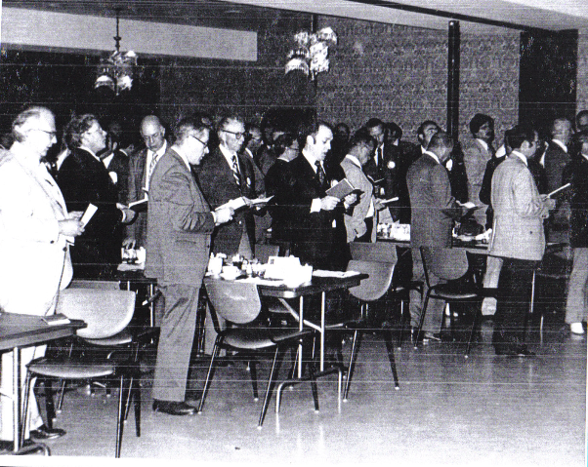
Club Meeting May 13, 1974

Slide 28
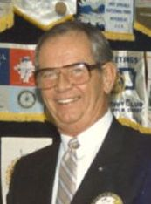
Donald Kirk President 1975-76

Slide 29
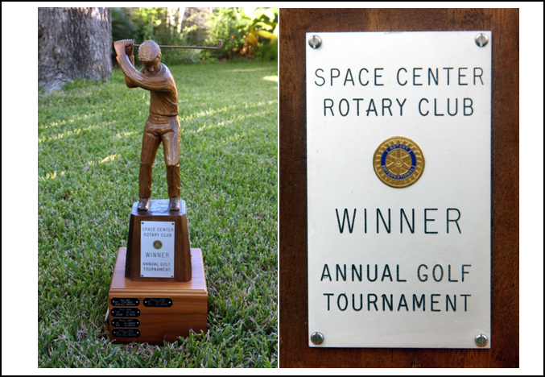
Club’s Golf Tournament Trophy 1975-1999

Slide 30
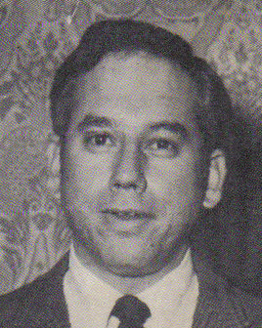
Dr. Lionel Gonzalo Garcia President 1976-77

Slide 31
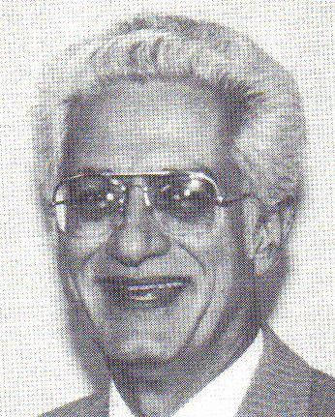
James "Jim" Lloyd Wyatt President 1977-78

Slide 32
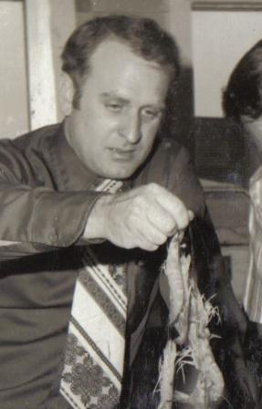
Marvin Matthews President 1978-79

Slide 33
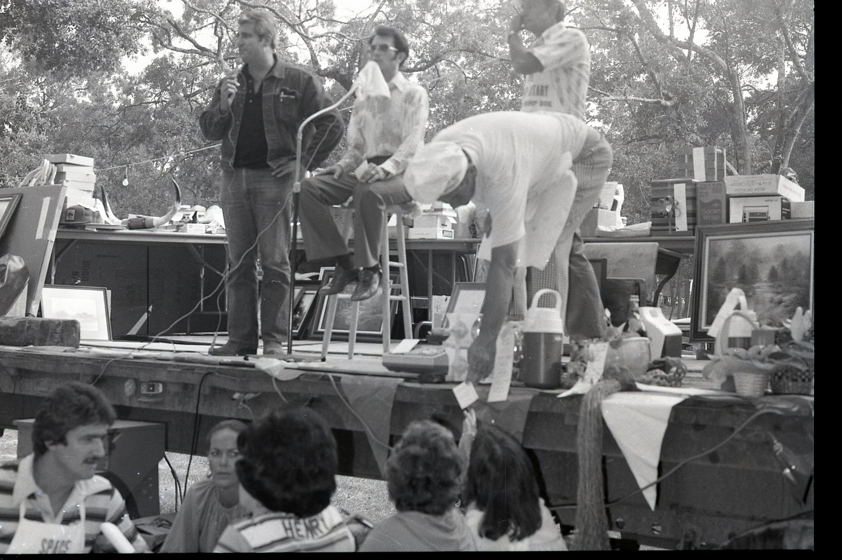
1978 Shrimporee

Slide 34
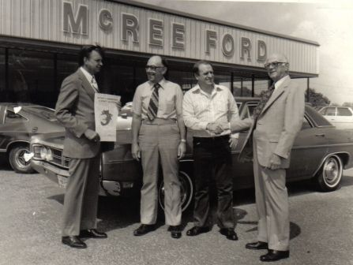
Car For Auction 1978 Shrimporee

Slide 35
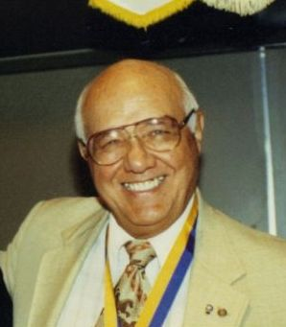
Kenneth A. Ligrani President 1979-80

Slide 36
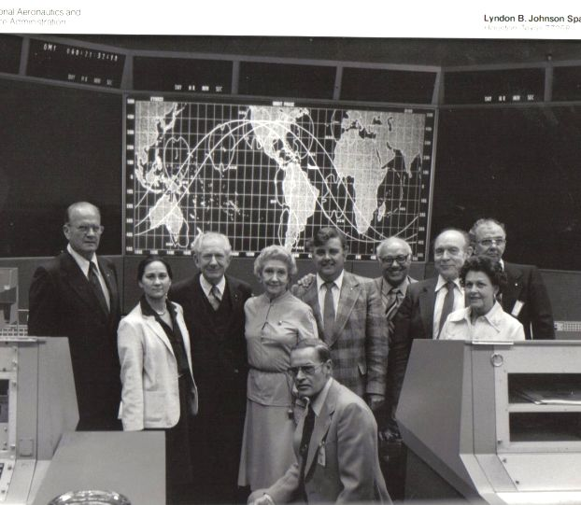
Rotary International President Visits Johnson Space Center - 1979

Slide 37
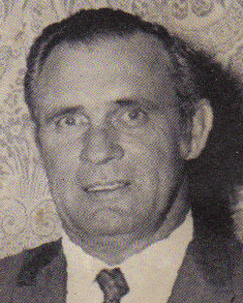
Chester E. "Pete“ Gist President 1980-81

Slide 38
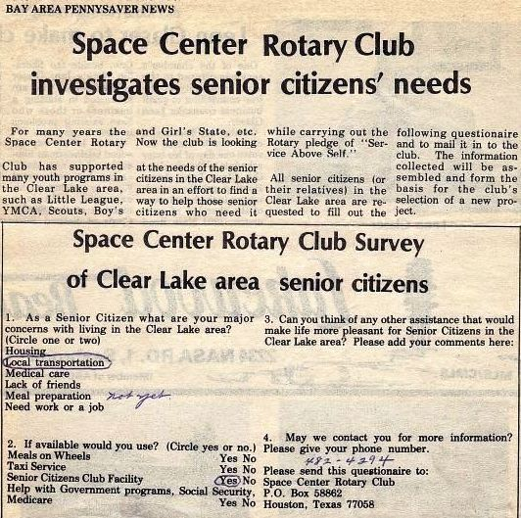
1980

Slide 39
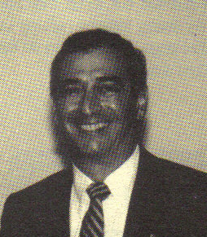
Mansour A. Jowid President 1981-82

Slide 40
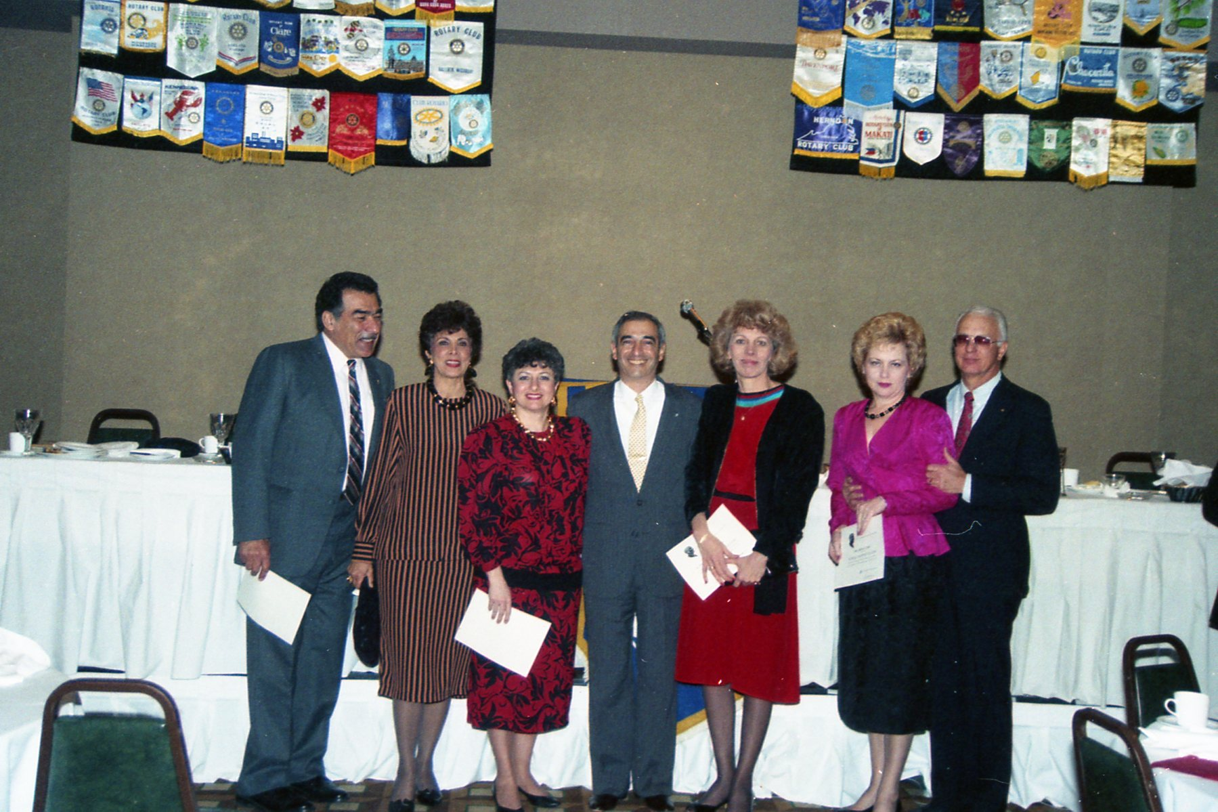
1981

Slide 41
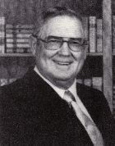
Dr. Floyd D. Boze Elected District 589 Governor 1981-82

Slide 42
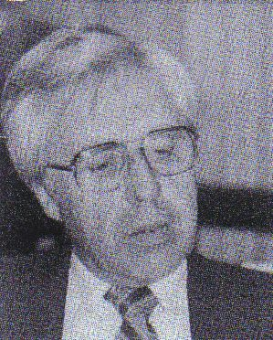
Charles "Chuck" A. Jacobson President 1982-83

Slide 43
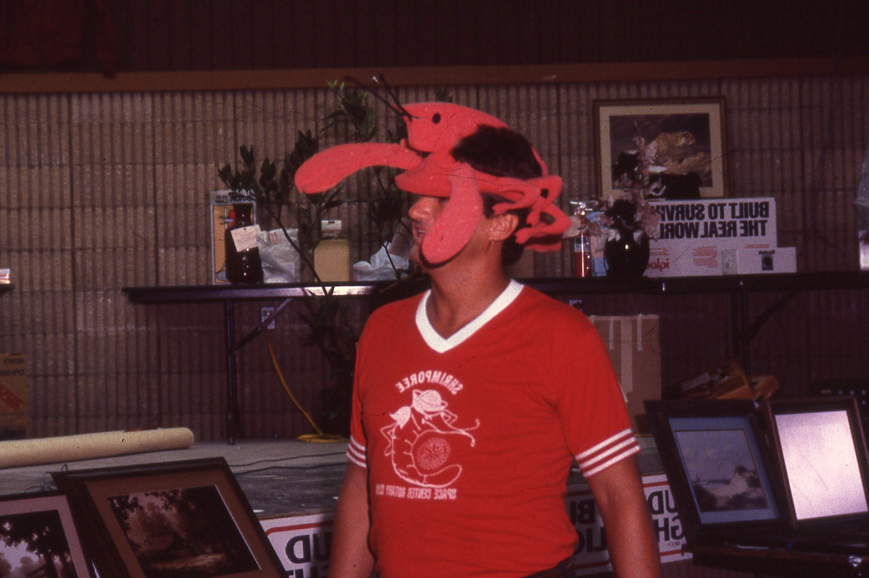
1983 Shrimporee

Slide 44
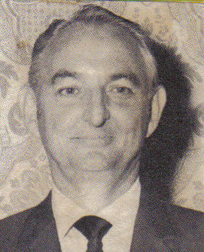
William "Bill" Joseph Webb President 1983-84

Slide 45
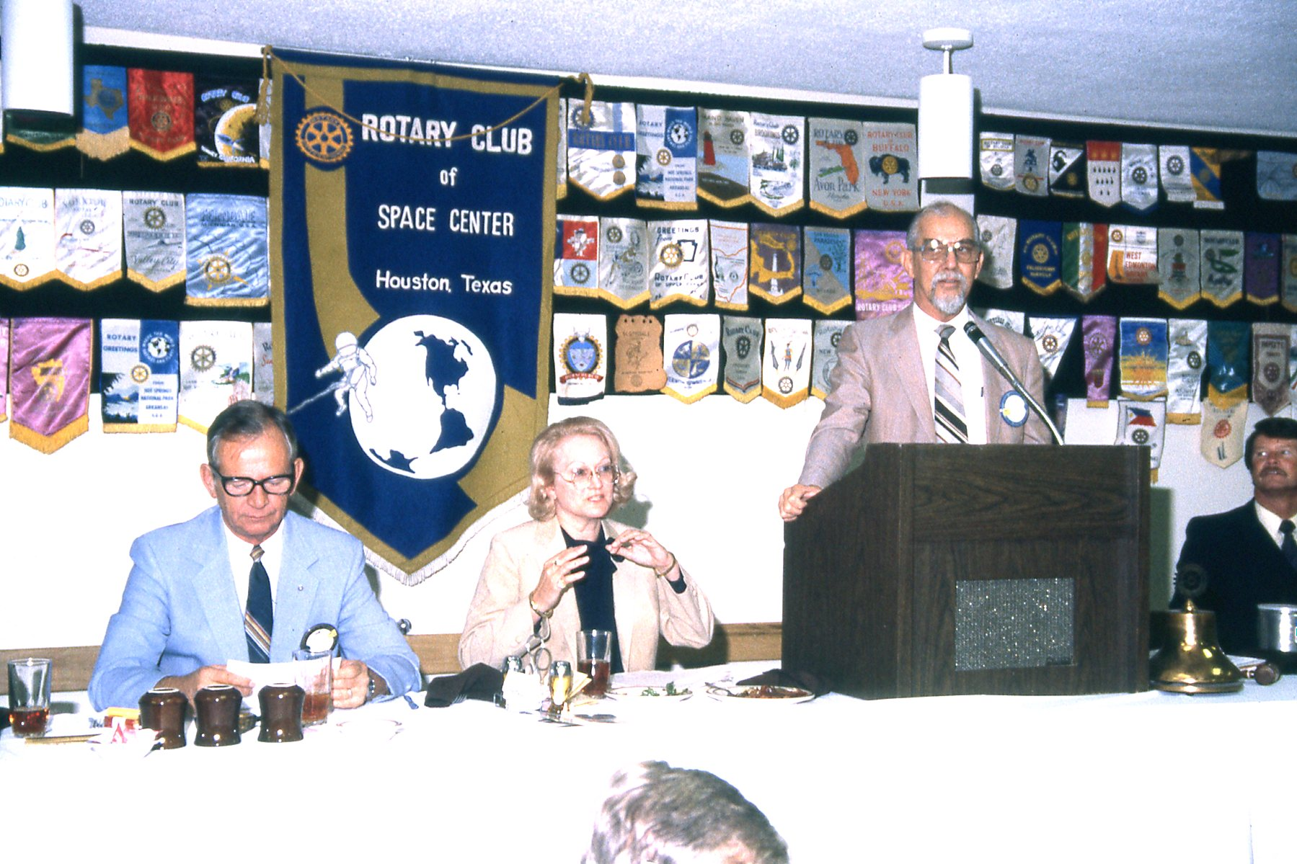
1984 (Note Banners Displayed)

Slide 46
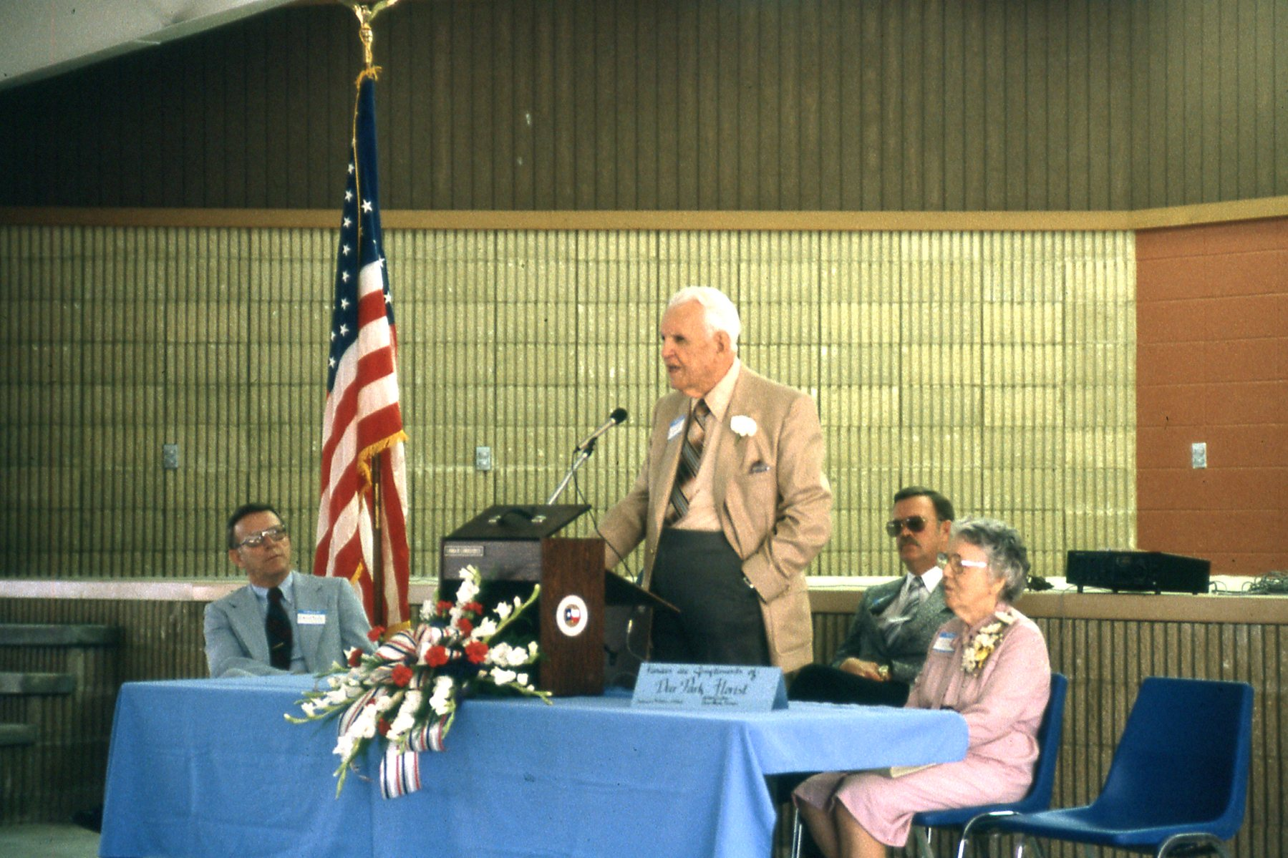
Dedication of Landolt Pavilion Club Member “Cap” Landolt speaking September 5, 1984

Slide 47
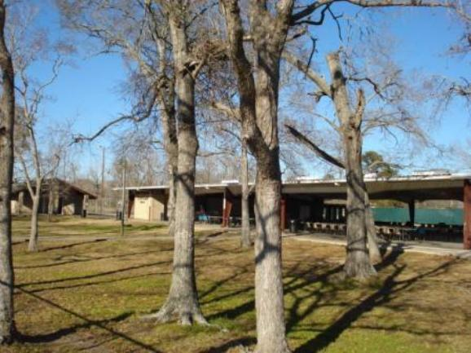
L.D. “Cap” Landolt Pavilion became the Home of the Shrimporee

Slide 48
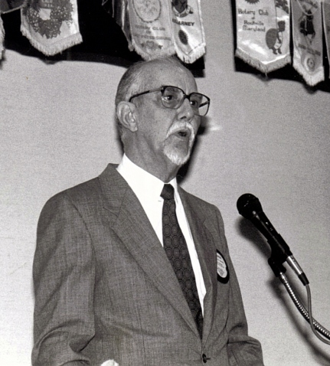
Charles Henry Hartman President 1984-85

Slide 49
Rotary National Award for Space Achievement
Charles Hartman (center) and Owen Morris (right) Founders of RNASA 1985
National Space Trophy

Slide 50
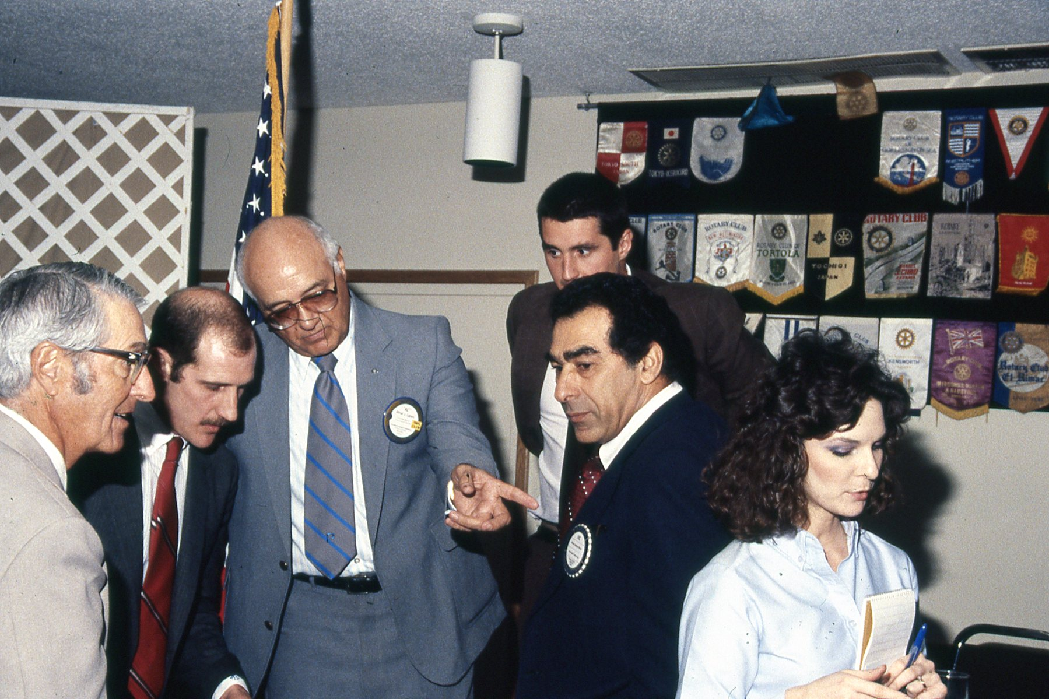
1985

Slide 51
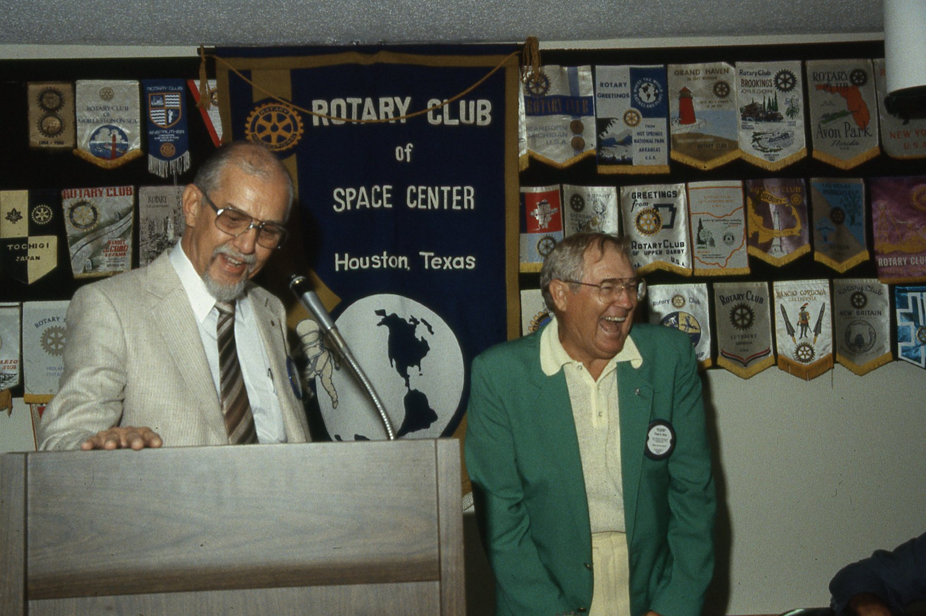
1985

Slide 52
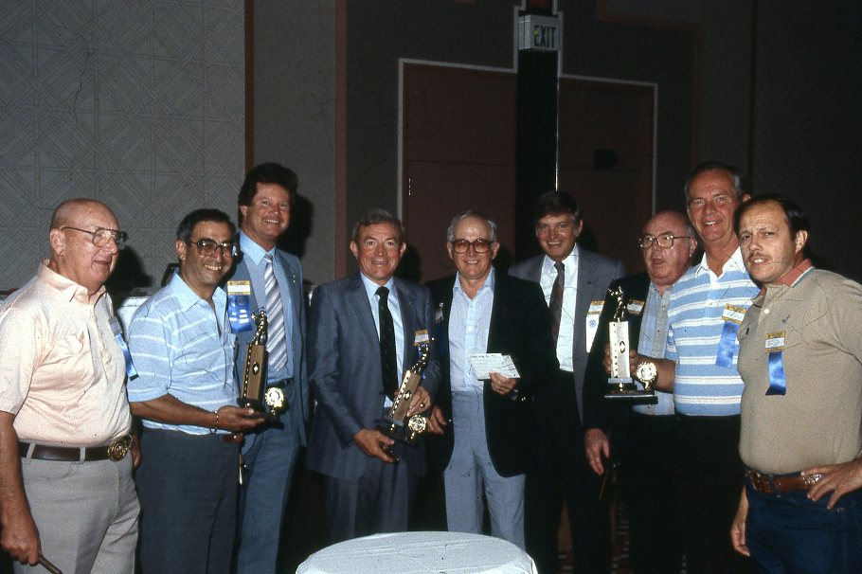
District Conference 1985

Slide 53
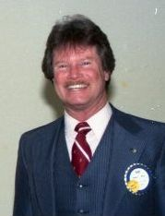
Robert James Wren President 1985-86

Slide 54
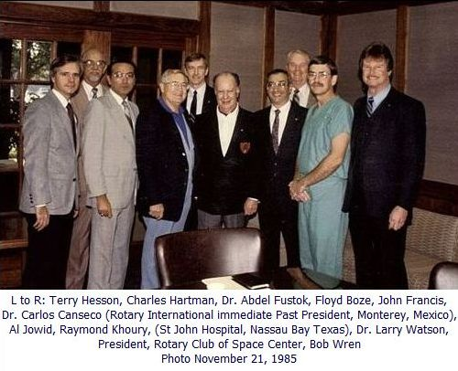
World Health Foundation founded 1985

Slide 55
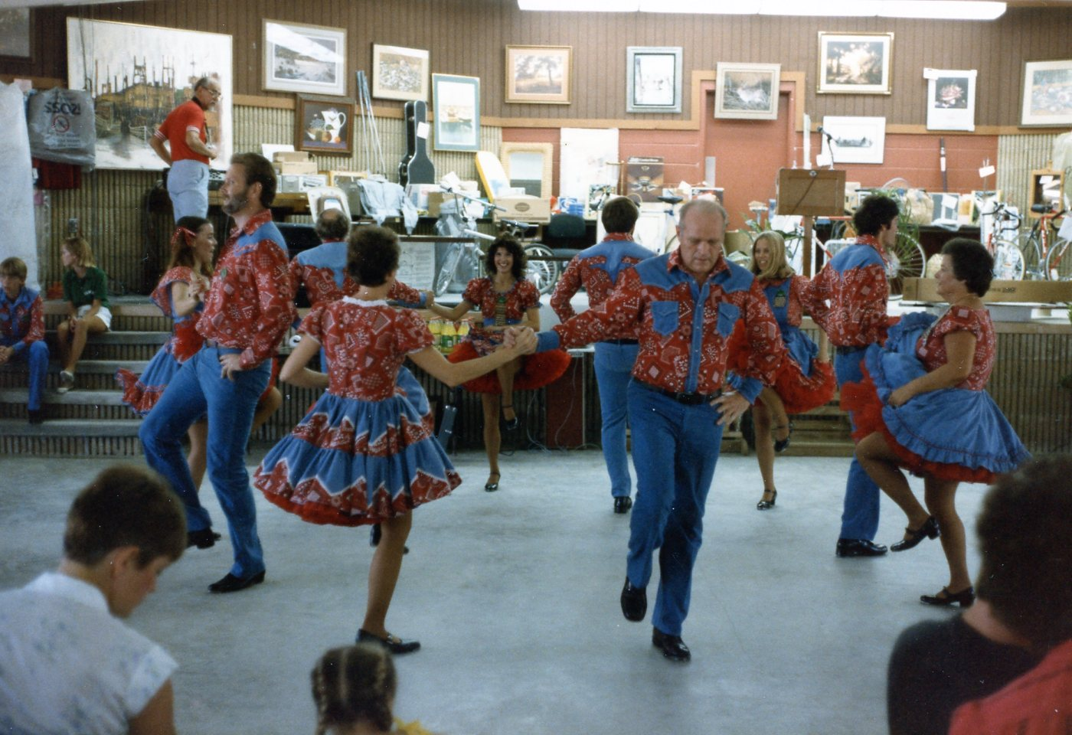
1985 Shrimporee

Slide 56
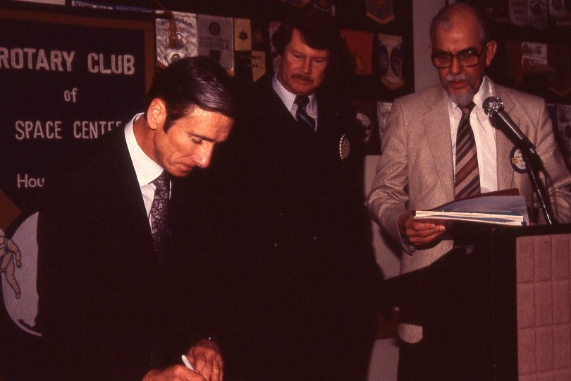
Astronaut John Young - 1985

Slide 57
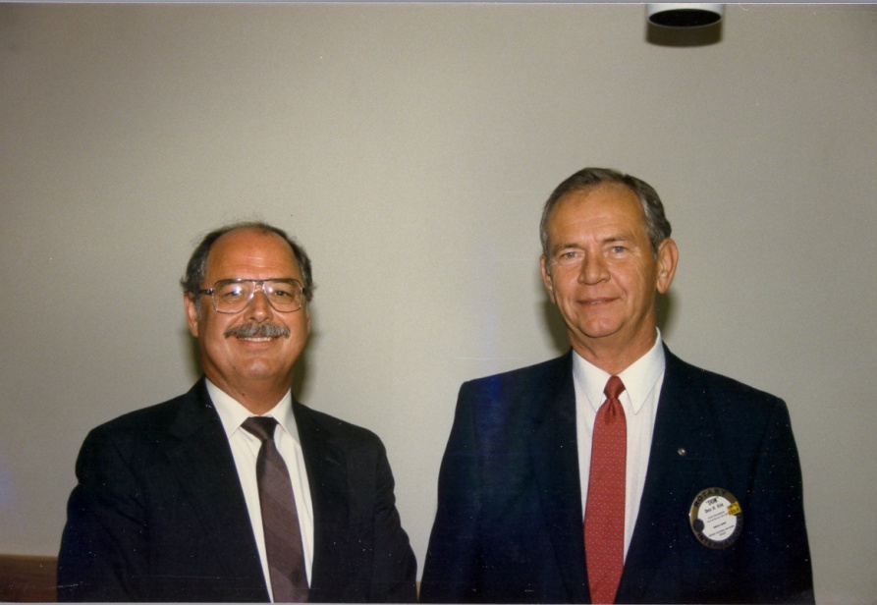

Slide 58
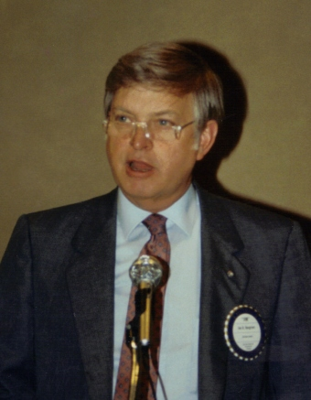
Jim Hargrove President 1986-87

Slide 59
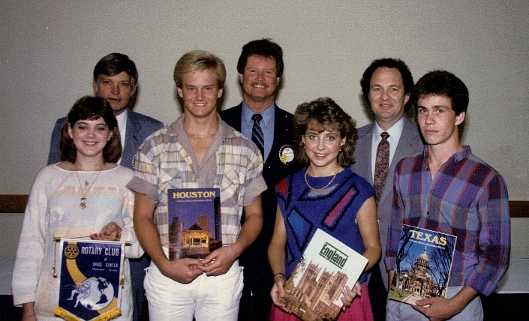
First International Youth Exchange Students 1986

Slide 60
Banner Exchange Sister Club Aeropuerto Rotary Club of Mexico City 1986

Slide 61
1986

Slide 62
50 Club Members, spouses, and friends in Austria for fellowship - 1986

Slide 63
Jim McNatt President 1987-88

Slide 64
First RNASA Award Dr. Maxime A. Faget March 12, 1987

Slide 65
1987

Slide 66
1987

Slide 67
Dr. Myra Gochnour-Hooker was the first woman inducted into the Club on November 16, 1987

Slide 68
Billy D. Weseman President 1988-89

Slide 69
1989

Slide 70
1989

Slide 71
John Watson President 1989-90

Slide 72
1989

Slide 73
1989

Slide 74
Billy R. Smith President 1990-91

Slide 75
Project Enterprise Seminar in Poland Started by Dr. David Taylor 1990

Slide 76
1990

Slide 77
Space Center Rotary Club Endowment Foundation founded February 15, 1991

Slide 78
Floyd D. Boze Fellowship
First Floyd Boze Fellowship to Nancy Boze 1991
Floyd Boze Medallion

Slide 79
Jack R. Lister President 1991-92

Slide 80
1991

Slide 81
Excellence In Education Started in 1991
Dr. David Taylor Created the Excellence in Education Awards
First Teacher of Year Award 1991

Slide 82
The Club sponsored the Seabrook Rotary Club which began with over 56 charter members October 1991

Slide 83
1992

Slide 84
1992

Slide 85
1992

Slide 86
Victor G. Maria President 1993-94

Slide 87
Bagpipes at President Maria’s Induction

Slide 88
1993

Slide 89
1993 Shrimporee

Slide 90
1993 Shrimporee

Slide 91
1993

Slide 92
1993

Slide 93
Over $18,500 and 450 bicycles and scooters have been given by Club members over years 1992 to 2003

Slide 94
First Excellence in Public Service Award started by Dr. David Taylor 1993

Slide 95
Billy D. Weseman Elected District 5890 Governor 1993-94

Slide 96
Dr. David T. Taylor President 1994-95

Slide 97
1994

Slide 98
1994 Shrimporee

Slide 99
Lamar D. Bowles President 1995-96

Slide 100
1995 Shrimporee

Slide 101
1995 Shrimporee

Slide 102
John W. Lowes, III President 1996-97

Slide 103
1996 Shrimporee

Slide 104
1996 District Conference

Slide 105
Donnie P. Johnson President 1997-98

Slide 106
1997 Shrimporee

Slide 107
1997 Shrimporee

Slide 108
1998 RNASA

Slide 109
Dick H. Gregg, Jr President 1998-99

Slide 110
1998

Slide 111
1999

Slide 112
William "Bill" H. Geissler President 1999-2000

Slide 113
1999

Slide 114
Shrimporee Shrimp and Fish Cooking Equipment - 1999

Slide 115
David Baldwin President 2000-01

Slide 116
President Baldwin instituted reciting the Four-Way Test at each Club meeting - 2001

Slide 117
Song Leader - 2000

Slide 118
Long Time Shrimporee Auctioneer Jim Fonteno - 2001

Slide 119
Second major fundraiser (Springoree) started in 2001
2011
2014

Slide 120
Susan "Suzi" Howe President 2001-02

Slide 121
2002 Pancake Breakfast

Slide 122
Suzi’s Party - 2002

Slide 123
Club Members built 110 benches commemorating Rotary’s Centennial Year 2002

Slide 124
Laura Hale President 2002-03

Slide 125
2002

Slide 126
Mystery Dinner -2002

Slide 127
2002

Slide 128
Shelia Self President 2003-04

Slide 129
2004 RNASA

Slide 130
2004 Shrimporee

Slide 131
2004

Slide 132
Dr. Vissett Sun President 2004-05

Slide 133
Rotary International President and wife visit Johnson Space Center - 2004

Slide 134
2005

Slide 135
J. B. Fox President 2005-06

Slide 136
District Conference - 2005

Slide 137
Suzi Howe Organized Refugee Influx during Hurricane Katrina - 2005

Slide 138
Club Members Builds Handicap Ramp 2005

Slide 139
Geoff Atwater lead efforts to rebuild playground at Pass Road Elementary School Gulfport, MS damaged by Hurricane Katrina 2006

Slide 140
Geoffrey Atwater President 2006-07

Slide 141
2006

Slide 142
2006

Slide 143
Club Meeting Then and Now
1974
2006

Slide 144
Long Time Pianist Ann Fulcher 2006

Slide 145
2006

Slide 146
Pancake Breakfast - 2007

Slide 147
2007

Slide 148
District Conference 2007

Slide 149
100% Paul Harris Club 2007 Suzi Howe and Geoff Atwater

Slide 150
Suzi C. Howe Elected District 5890 Governor 2006-07

Slide 151
Dick Gregg III President 2007-08

Slide 152
2007 Shrimporee

Slide 153
2007 Shrimporee

Slide 154
2008 Springoree

Slide 155
2008

Slide 156
Mike A. Hernandez President 2008-09

Slide 157
2008 Shrimporee

Slide 158
2008

Slide 159
Guest Judge Emmett - 2008

Slide 160
Dick Meyers rides for Marine Sergeant Hector Marin 2008

Slide 161
Remembering Club Members Memorial 2009

Slide 162
Jon McKinnie President 2009-10

Slide 163
2009

Slide 164
2009

Slide 165
2009

Slide 166
2009

Slide 167
2009

Slide 168
Club Members Help Build Home 2010

Slide 169
Jon McKinnie Day 2010

Slide 170
David B. Coney President 2010-11

Slide 171
Floyd Boze Day February 2010

Slide 172
US Congressman Pete Olson and Friends Shrimporee 2010

Slide 173
2010 Shrimporee

Slide 174
2010

Slide 175
2010

Slide 176
Charter Member Vince Lipovsky 2010

Slide 177
District 5890 Rotary Youth Exchange Committee awarded the outstanding youth exchange district award for all of North America - United States, Canada, and Mexico 2010

Slide 178
2011

Slide 179
2011 Springoree

Slide 180
Michael D. Dennard President 2011-12

Slide 181
2011

Slide 182
2011

Slide 183
2011

Slide 184
2011 Shrimporee

Slide 185
2011

Slide 186
2011

Slide 187
2011

Slide 188
2011

Slide 189
Floyd Boze Dinner February 2012 Floyd’s 94th Birthday
District Governors attending Floyd Boze Dinner
Floyd Boze Family

Slide 190
Marilyn Musial President 2012-13

Slide 191
Club Member Greg Smith Superintendent of Year 2012

Slide 192
2012

Slide 193
2012 Shrimporee

Slide 194
Early Act First Knight started at Whitcomb Elementary by President Musial

Slide 195
President Receives Peace Award 2013

Slide 196
Sheryl Berg President 2013-14

Slide 197
2013

Slide 198
2013

Slide 199
David Sincox 40 Years of working Shrimporee
1974 (One with beard)
2013

Slide 200
2013

Slide 201
2013

Slide 202
J B Fox at 91 2013

Slide 203
2014

Slide 205
Go and Do Likewise

Slide 206
Noel Bajat, Ron Burton, Scott Rainey

